Slide 1

EMBSYS 105 Programming with Embedded & Real-Time Operating Systems
Instructor: Nick Strathy, nstrathy@uw.edu
TA: Gideon Lee, gideonhlee@yahoo.com
© N. Strathy 2020
Lecture 7 2/24/2020

Slide 2
Looking ahead
Date | Lecture number | Assignment
1/6 | L1 | A1 due* before L2
1/13 | L2 | A2 due before L3
1/20 | L3 | A3 due before L4
1/27 | L4 | A4 due before L5
2/3 | L5 | A5 due before L7, Project due before L10
2/10 | L6
2/17 | Holiday – enjoy!
2/24 | L7
3/2 | L8, Guest Lecture: Bill Lamie (CEO) & Yuxin Zhou VP Eng of Express Logic
3/9 | L9
3/16 | L10 – Student presentations
* Assignments are due Sunday night at 11:59 PM

Slide 3
Previous Lecture (L6) Overview
Connecting jumper wires to make the LCD work
Event driven MP3 player
Task priorities - Rate monotonic scheduling
Adding I2C driver to PJDF
Tracing uCOS message queue
Explore graphics library – Button class

Slide 4
Current Lecture (L7) Overview
Assignment 5 Touch Driver
Project design suggestions
GenerateMp3Header.ps1 tool
Audacity tool
Reducing Code Memory footprint
Communicating with the vs1053 Chip
Fun: previous generation MP3 Player
SD/MMC
FAT File System
Read a directory with Arduino SD library

Slide 5
LCD/wires issue
Did everyone receive their wires? If not let me know ASAP.
With the wires (and extra headers), your LCD should now work.

Slide 6
Assignment 5 Touch Driver
At this point in the course, you should have a touch driver working.
If your PJDF driver is not working yet
You should put it on hold and come back to it later if there’s time
Move on to the project using your non-PJDF driver

Slide 7
Assignment 5 Touch Driver
Touch should work when starting up the application in the debugger (assuming you have I2C initialized and you disable interrupts for I2C transactions)
Summary of hardware issues with touch driver:
Due to hardware changes in this year’s board, touch hangs if
you start up the board without the debugger
you use multi-touch
You are not required to fix these issues

Slide 8
Assignment 5 Touch Driver
However, to make touch work when not starting up in the debugger:
Remove the jumper underneath the upper right corner of your Nucleo and use it to connect C1 to R4 beside the USB connector on the Nucleo.
Add a delay like this in main():
Hw_init();
delay(100000);
I2C1_init();

Slide 9
Assignment 5 Touch Driver
Sketch for a workaround for multi-touch hang:
Add code to time-out when checking the I2C status
If timeout happens reset I2C hardware

Slide 10
MP3 Player Display
Song title
A solution
Song progress
Fly Me to the Moon
Play
Stop
Pause
Next
Prev
Vol+
Player status
Vol-
Playing…

Slide 11
MP3 tasks
Touch input handler
A solution
Input Command
Command handler
Stream Command
Display Command
MP3 streamer
Display handler
Display Command
MP3 decoder
updates
Display
MP3 data

Slide 12
Touch input task
A solution
Touched?
Map (x,y) to a button (stop/start/pause/vol-up/vol-down/etc)
Start
yes
no
Post event to Command Mailbox (stop/start/pause/vol-up/etc)
Short
delay

Slide 13
Command handler task
A solution
Handle Play; enqueue display updates
Pend on mailbox for command (Play, Stop, etc)
Handle Stop; enqueue display updates
Start
Handle Pause; enqueue display updates
Handle Vol-up; enqueue display updates
Handle Vol-down; enqueue display updates
. . .

Slide 14
Display handler task
A solution
Update display for Play
Pend on queue for command (Play, Stop, etc)
Update display for Stop
Start
Update display for Pause
Update display for Vol-up
Update display for Vol-down
Update display for progress

Slide 15
Streaming task
Play/Stop flow chart with progress update – a solution
Busy-wait for playerStatus to change to Playing
Setup streaming
More data and playerStatus == Playing?
Start
yes
no
Stream a chunk to
the MP3 decoder;
Enqueue progress update to display
playerStatus = Stopped;
Do stuff to stop streaming

Slide 16
Demo GenerateMp3Header.ps1
Powershell script in MP3Player starter app:
Script location in the project: MP3data/GenerateMp3Header.ps1
You may need to allow PS scripts to run on your machine, so launch Powershell in administrator mode:
Locate Powershell app in start menu
Right-click/Run as Administrator
To allow Powershell scripts to run enter this command:
Set-ExecutionPolicy Bypass
Powershell has an inconvenient way of determining the current path, so just use full filepathnames as shown in the example in the script

Slide 17
Audacity
Audacity® is free, open source, cross-platform audio software for multi-track recording and editing.
Can select a portion of audio track and “Export audio …”
Can select bit rate for MP3 export

Slide 18
MP3 bit rates
Handling high MP3 bit rates
MP3 is a lossy audio compression format
Bit rate can vary from file to file, even within a file
Highest standard bit rate is 320 kbit/s
Problem: we have up to 3 devices contending for exclusive access to the SPI bus (MP3 chip, LCD, SD)

Slide 19
MP3 bit rates
Handling high MP3 bit rates
Vs1053 chip asserts DREQ high when it is ready for data
It will accept a minimum of 32 bytes when DREQ is high
Problem: if the file is encoded at 320 kbit/s it will take as little as 0.8 ms to play 32 bytes – result: 0.8 ms music then we need another 32 bytes
However, Vs1053 internal buffer holds up to 2048 bytes
Solution: we keep feeding 32-bytes to the decoder while DREQ is high and only delay the streaming task when DREQ goes low.

Slide 20
MP3 bit rates
Logic to allow high MP3 bit rates
Low level streaming logic (built in to PJDF driver):
Repeat:
while DREQ is low
delay some ticks (allow lower priority tasks to run)
send 32 bytes

Slide 21
Reducing code footprint
We are limited to 32kB Code by the IAR free license
Find your project’s memory usage in .map file in the EWARM project Output folder
Can remove uCOS unused features in App/uCOS/os_cfg.h
Maybe reclaim 100’s of bytes
SD card driver takes ~7kB of code → if you use it, you may have to eliminate some other features – trade-off.
If IAR Tiny stdio printf were not so small we could use our built-in printf
Caveat: ours is not thread safe, max int is 16 bits

Slide 22
Communicating with the vs1053 Chip

Slide 23
Communicating with the vs1053 Chip
References
Adafruit Music Maker Shield: https://learn.adafruit.com/downloads/pdf/adafruit-music-maker-shield-vs1053-mp3-wav-wave-ogg-vorbis-player.pdf
User manual STM32 Nucleo-64 boards: http://www.st.com/st-web-ui/static/active/en/resource/technical/document/user_manual/DM00105823.pdf
VS1053b Datasheet: http://www.vlsi.fi/fileadmin/datasheets/vs1053.pdf
The application controls the vs1053 chip by sending commands to the chip’s Serial Command Interface (SCI) bus via SPI1 bus connected to the host.
MP3 data is sent to the chip’s Serial Data Interface (SDI) bus also via SPI1.
We control which bus is selected by the GPIO chip select lines defined in bspMp3.h:
MP3_VS1053_MCS_GPIO/_Pin : assert this low to send commands to the chip
MP3_VS1053_DCS_GPIO/_Pin: assert this low to send data to the chip
A 3rd GPIO is used by the vs1053 to notify the host when more data can be sent to the decoder:
MP3_VS1053_DREQ_GPIO/_Pin: asserted high by vs1053 when ready to receive data

Slide 24
Communicating with the vs1053 Chip
There are three 'totally fixed' pins, the hardware SPI pins:
SPI SCK - connected to Digital #13 (but can be connected to the ISP header with a jumper) used by both the SD card and VS1053
SPI MISO - connected to Digital #12 (but can be connected to the ISP header with a jumper) used by both the SD card and VS1053
SPI MOSI - connected to Digital #11 (but can be connected to the ISP header with a jumper) used by both the SD card and VS1053
There are a couple of other pins that are required for talking to the VS1053 to play MP3s and such
MCS - this is the VS1053 chip select pin, connected to Digital #7
DCS - this is the VS1053 data select pin, connected to Digital #6
CCS - this is the SD Card chip select pin, connected to Digital #4
DREQ - this is the VS1053 data request interrupt pin - connected to digital #3

Slide 25
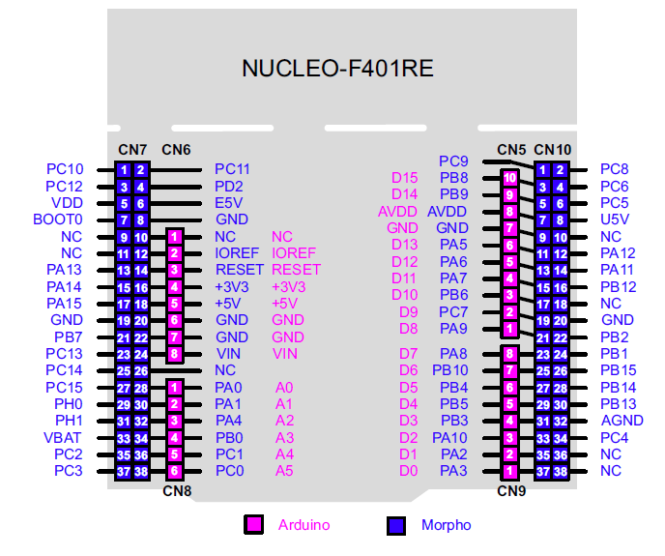
Communicating with the vs1053 Chip
SPI SCK – D13 PA5
SPI MISO – D12 PA6
SPI MOSI – D11 PA7
MCS – D7 PA8
DCS – D6 PB10
DREQ – D3 PB3

Slide 26
Communicating with the vs1053 Chip
Put chip in command mode
Ioctl(hMp3, PJDF_CTRL_MP3_SELECT_COMMAND, 0, 0);
Meaning: Our MP3 driver will ensure that MCS is asserted for any subsequent writes to the vs1053
Put chip in data mode
Ioctl(hMp3, PJDF_CTRL_MP3_SELECT_DATA, 0, 0);
Meaning: Our MP3 driver will ensure that DCS is asserted for any subsequent writes to the vs1053

Slide 27
Communicating with the vs1053 Chip
Soft chip reset
Reset the chip by sending the serial command bytes in const char array BspMp3SoftReset[]:
const INT8U BspMp3SoftReset[] = { 0x02, 0x00, 0x08, 0x04 };
0x02 is the SCI write register command (see p. 21 Data Sheet)
0x00 is the address of the SCI_MODE register (see p. 38 Data Sheet)
0x08, 0x04 specifies the 16-bit register value with most significant byte first. Two bits are set to: cancel decoding any current file (SM_CANCEL), and reset for new serial data SM_SDINEW (see p. 39 Data Sheet).

Slide 28
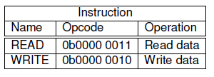
Communicating with the vs1053 Chip
Serial Protocol for Serial Command Interface (SPI/SCI)
p. 21 of VS1053b Datasheet

Slide 29
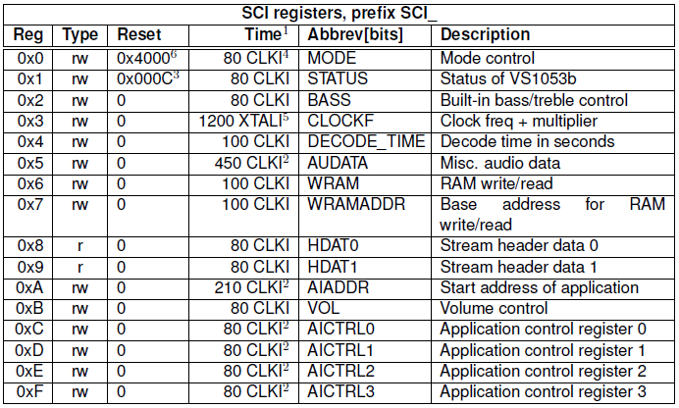
Communicating with the vs1053 Chip
p. 38 of VS1053b Datasheet

Slide 30
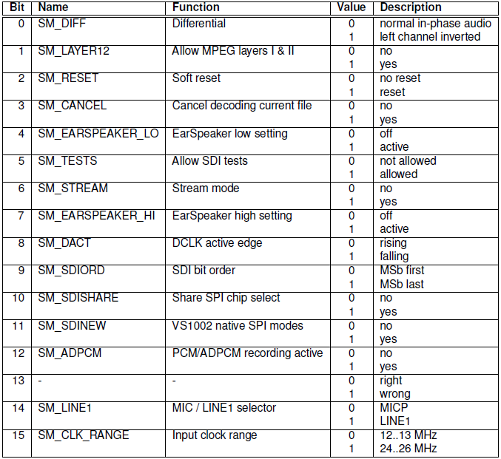
Communicating with the vs1053 Chip
p. 39 of VS1053b Datasheet

Slide 31
Communicating with the vs1053 Chip
Play an MP3 file
Configure MP3 driver to send a command on the serial command interface bus:
Ioctl(hMp3, PJDF_CTRL_MP3_SELECT_COMMAND, 0, 0);
Send serial command interface command to enter play mode:
const INT8U BspMp3PlayMode[] = { 0x02, 0x00, 0x08, 0x00 };
0x02 is the SCI write register command (see p. 21 Data Sheet)
0x00 is the address of the SCI_MODE register (see p. 38 Data Sheet)
0x08, 0x00 specifies the 16-bit register value with most significant byte first. One bit is set to reset for new serial data SM_SDINEW (see p. 39 Data Sheet).

Slide 32
Communicating with the vs1053 Chip
Play an MP3 file cont’d
Select serial data interface bus by configuring as follows:
Ioctl(hMp3, PJDF_CTRL_MP3_SELECT_DATA, 0, 0);
Now we can send bytes of MP3 data to the vs1053 chip by writing to the MP3 driver and they will get sent to the serial data interface on the vs1053 chip and converted to audio signals by the chip.
DREQ – we wait for this signal to assert high before sending the next chunk of 32 bytes to the decoder.

Slide 33
Demo of previous generation MP3 Player

Slide 34
SD/MMC

Slide 35
SD/MMC
Introduction
SD is a popular flash memory technology that evolved from MMC
The SD Standard is an “open” standard maintained by the Secure Digital Association (www.sdcard.org) – open, yes, but have to purchase licence
MMC – MultiMedia Card technology developed by SanDisk and Siemens in 1997.
SD – Secure Digitial card extends MMC technology – developed by SanDisk, Matsushita (Panasonic), and Toshiba, and introduced in 1999
MMC cards are harder to find now than SD cards. We will focus mainly on SD.

Slide 36
SD/MMC
SD/MMC Physical comparison:
SD slots will accept MMC cards.
SD has 9 pins, MMC has 7
SD usually has a physical sliding write-protect lock, MMC does not
Predecessor technology worth mentioning: CompactFlash first introduced by SandDisk in 1994 predates MMC and SD. Still used for high end video. Larger form factor than SD/MMC.
SD cards come in 3 form factors: standard, mini, micro
Capacities:
SD – standard capacity: 1 – 2 GB, sometimes 4 GB
SDHC (2006) – high capacity: up to 32 GB
SDXC (2009) – extended capacity: up to 2 TB

Slide 37
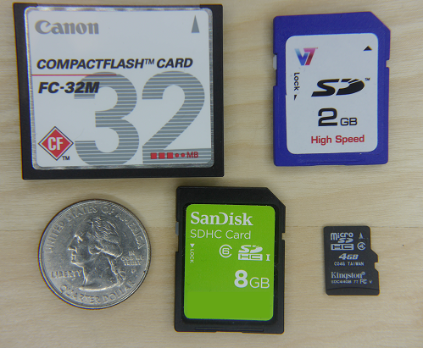
Clockwise from top left:
32 MB CompactFlash card: a related technology worth mentioning. CompactFlash first introduced by SandDisk in 1994 predates MMC and SD. Still used for high end video.
standard form factor 2 GB SD card
4 GB micro SDHC card
8 GB SDHC card
25-cent coin for scale

Slide 38
SD – Speed
Class | Minimum performance | Application
Class 2 | 2 MB/s | SD video recording
Class 4 | 4 MB/s | High-definition video (HD) recording including Full HD (from 720p to 1080p/1080i)
Class 6 | 6 MB/s
Class 10 | 10 MB/s | Full HD (1080p) video recording and consecutive recording of HD stills (high-speed data bus)
UHS Speed Class 1 (U1) | 10 MB/s | Real-time broadcasts and large HD video files (UHS bus)
UHS Speed Class 3 (U3) | 30 MB/s | 4K video files (UHS bus)
Source: Wikipedia

Slide 39
SD
SDIO – another family of SD devices
not simply a memory card but a general purpose I/O scheme using the SD interface
for devices like wireless adapters, Bluetooth, barcode scanners, etc.
largely superseded by USB
Card Security features
Read-only physical lock (not on microSD)
Reversible and non-reversible commands to disable writing
Card password – up to 16 bytes
DRM copy protection (rarely used feature): ~10% of SD capacity is a “protected area” not available to the user. Used to verify the identity of an application program.
The DRM protected area may be erased by reformatting. To avoid that can download the formatter from sdcard.org.

Slide 40
SD
Electrical interface
Initially uses 3.3 volts. On command, SDHC, SDXC cards switch to 1.8 V operation
Initial clock speed should be 400 kHz when determining the card’s capabilities after which the “default” speed of 25 MHz may be used
SPI interface
SD cards have a built in SPI interface
This allows them to be used as non-volatile memory by embedded controllers without having to implement the full SD interface
Error detection/correction
Read/write operations on the NAND flash technology used in SD cards may have errors therefore every operation includes a CRC (cyclic redundancy checksum)
If an error is detected the operation is repeated by controller until success

Slide 41
SD
Storage format
Block character device
Data is read and written in blocks of fixed size
Blocks may be accessed in random order
The SD standard specifies these file formatting systems
SD – Up to 2 GB using FAT 12 and 16
SDHC – over 2GB-32GB using FAT32
SDXC – over 32GB-2TB using exFAT (Microsoft standard)

Slide 42
SD/MMC
References
https://www.sdcard.org/
“Simplified” specs can be downloaded free
Full specs require license fee
http://en.wikipedia.org/wiki/Secure_Digital
http://en.wikipedia.org/wiki/MultiMediaCard
http://en.wikipedia.org/wiki/CompactFlash

Slide 43
FAT File System
Introduction
The File Allocation Table (FAT) File System was developed by Microsoft as a way of organizing data into files and directories on a magnetic disk.
Cluster: The disk is divided into equal size units called clusters
File: A file is an entity with a name, some attributes like timestamp, and a chain of clusters containing the file contents
Directory: A directory is a special file containing a list of file names, their attributes, and their starting clusters
History
1979 – 8-bit FAT entries – allowed 2^8 clusters
1981 – 12-bit FAT entries – MS-DOS 1.0 – allowed 2^12 clusters
1984 – 16-bit FAT entries – MS-DOS 3.0 – allowed 2^16 clusters
1996 – 32-bit FAT entries – MS-DOS 7.1 – allowed 2^32 clusters
Today, the same FAT file system technology developed for magnetic disks is commonly repurposed for use on Flash devices like USB memory keys and SD Cards

Slide 44
FAT File System
Terms
Sector – smallest unit of read/write storage access – 512 bytes == block size
Cluster – smallest unit of file storage – a set of contiguous sectors – a power of 2 – commonly 32768 bytes for SD cards
File – a chain of clusters
Directory
a special kind of file containing a list of files and their starting clusters
A directory file may contain other directory files resulting in a tree structure of directories
File Allocation Table (FAT) – contains an entry for every cluster:
Zero indicates an unallocated cluster
0xFFFF indicates last cluster of a file (FAT16)
Any other value indicates next cluster in a file

Slide 45
FAT File System
Terms cont’d
Volume
A floppy disk, hard disk drive, USB memory stick, SD Card, etc. organized as a FAT file system
Boot Sector, BIOS Parameter Block (BPB), Zeroth Sector, Reserved Sector
All these terms refer to the first sector (Sector 0) on a FAT volume which contains critical information to allow the data on the volume to be read and written
Single point of failure for FAT file system
Root Directory
The file containing the starting directory of the directory tree of the volume
On FAT32 it is a file like any other, on FAT12 and FAT16 it is of fixed length
Partition
(Volume) – division of a hard disk into multiple logical hard disks each with a file system
Standard FAT sizes – we’ll focus on FAT32 since it is standard for SDHC
FAT12 – allows for 2^12 = 4096 clusters – used for floppy disks
FAT16 – allows for 2^16 = 65,536 clusters – up to 2 GB
FAT32 – allows for 2^32 = 4,294,967,296 clusters – up to 2 TB

Slide 46
FAT File System
Simple Volume Layout
Reserved
Area
Root
Directory
 | FAT Area |  | Data Area

Slide 47
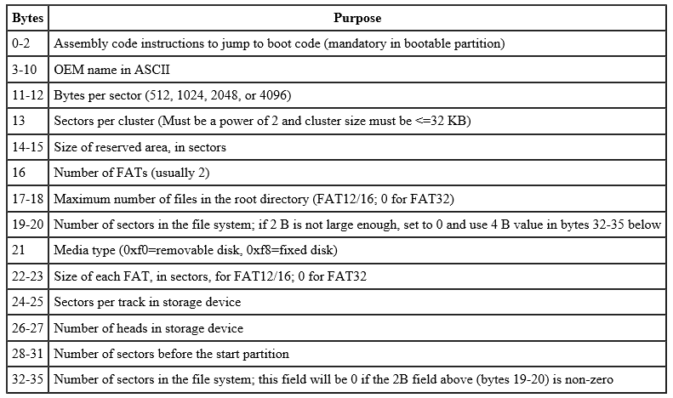
FAT File System - Boot sector
Boot Sector bytes 0-35

Slide 48
FAT File System – Boot Sector
Bytes | Purpose
36-39 | FATSz32 - Count of sectors occupied by one FAT
40-41 | ExtFlags – flags for active and mirrored FAT
42-43 | FSVer – version number
44-47 | RootClus – cluster number of first cluster of the root directory
48-49 | FSInfo – sector number of the FSINFO structure in the reserved area of the FAT32 volume. Usually 1.
50-51 | BkBootSec – if non-zero, indicates the sector number in the reserved area of the volume of the copy of the boot record. Usually 6. No value other than 6 is recommended.
52-63 | Reserved
64 | DrvNum – drive number of the media
65 | Reserved1
Boot Sector bytes 36-65
Specific to FAT32

Slide 49
FAT File System – Boot Sector
Boot Sector bytes 66-89
Specific to FAT32
Bytes | Purpose
66 | BootSig – Extended boot signature (0x29). Indicates that the following 3 fields in the boot sector are present
67-70 | VolID – Volume serial number.
71-81 | VolLab – matches the 11-byte volume label recorded in the root directory
82-89 | FilSysType – Always set to the string “FAT32 “ for FAT32 volumes
IMPORTANT: Additionally, for the boot sector of a FAT volume, byte 510 equals 0x55 and byte 511 equals 0xAA.

Slide 50
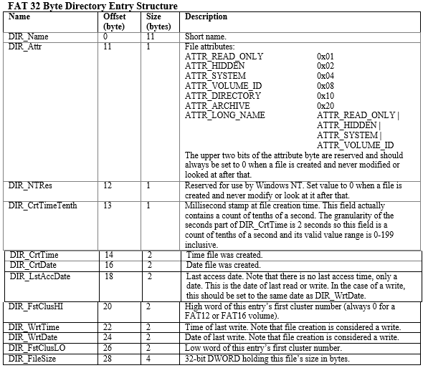
FAT file system
Contents of a directory entry structure
32 bytes long

Slide 51
FAT File System
Example file tree
Contains 3 text files and 2 nested directories
E:\
| File1.txt
|
\---Dir1
| File2.txt
|
\---Dir2
File3.txt

Slide 52
FAT file system Conceptual example
File
Allocation
Table
Cluster = 8 sectors
(reality: usually 64
Sectors for FAT32)
0 | 1
1 | FFFF
2 | 3
3 | FFFF
4 | FFFF
5 | 9
6 | FFFF
7 | 10
8 | FFFF
9 | 6
10 | FFFF
11 | 0
12 | 7
0
1
2
3
4
5
6
7
8
9
10
11
12
Root
Directory
(Cluster 0)
Name | Attributes | Cluster
File1 | <attributes> | 2
Dir1 | <attributes> | 4
Dir1
Name | Attributes | Cluster
. | <attributes> | 4
.. | <attributes> | 0 (Root)
Dir2 | <attributes> | 8
File2 | <attributes> | 5
First usable cluster is 2.
0 means unallocated cluster.
FFFF means last cluster of a file.
.
.
.
Dir2
Name | Attributes | Cluster
. | <attributes> | 8
.. | <attributes> | 4
File3 | <attributes> | 12
.
.
.

Slide 53
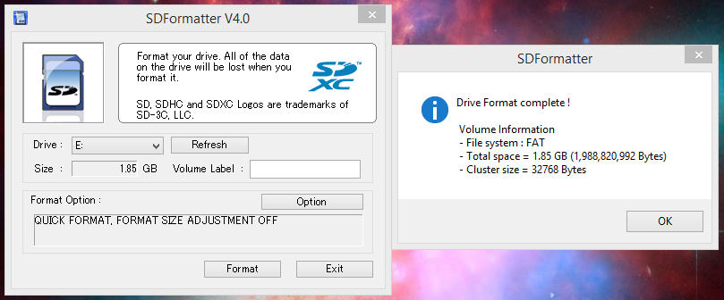
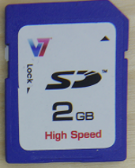
FAT File System
Download SDFormatter.exe from sdcard.org
Over time, FAT gets fragmented as files are deleted/created
Formatting recreates a new FAT (old file data still present but cluster chains are lost)
FAT (16) entries = DiskCapacity / ClusterSize = 1,988,820,992 / 32768 = 60,694

Slide 54
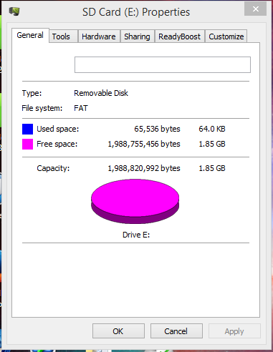
FAT File System
Formatted empty SDSC
2 clusters used

Slide 55
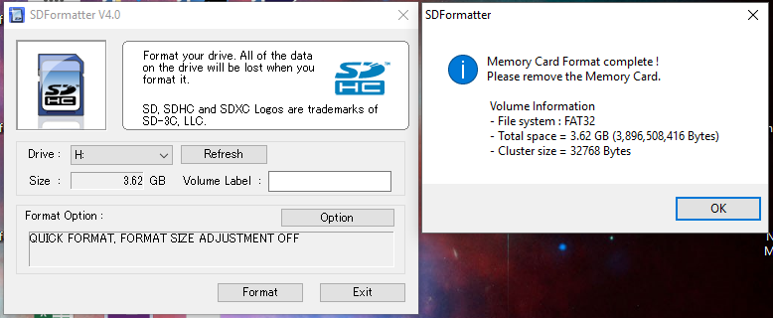
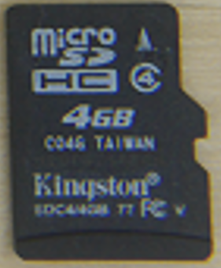
FAT File System
Micro SDHC High Capacity 4 GB
FAT32 entries = DiskCapacity / ClusterSize = 3,896,508,416 / 32768 = 118,912

Slide 56
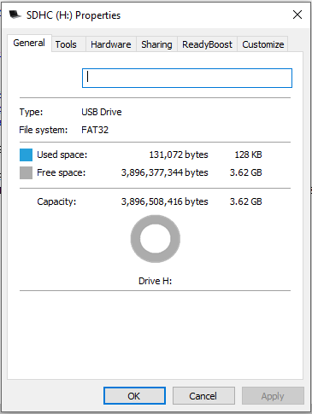
FAT File System
Formatted empty SDHC
4 clusters used

Slide 57
FAT File System
FAT References
FAT File System, Igor Kholodov, 2010
http://www.c-jump.com/CIS24/Slides/FAT/lecture.html#F01_0010_overview
FatFs – Generic FAT File System Module, 2015
http://elm-chan.org/fsw/ff/00index_e.html
File Allocation Table, Wikipedia, 2015
http://en.wikipedia.org/wiki/File_Allocation_Table
Microsoft EFI FAT32 File System Specification, Microsoft, 2000
https://msdn.microsoft.com/en-us/windows/hardware/gg463080.aspx

Slide 58
Read a directory with Arduino SD library
Sample code in Canvas:
“SD sample code.txt”

Slide 59
Read a directory with Arduino SD library
Requires dynamic allocation:
uCOS memory partitions enabled in App/uCOS/os_cfg.h:
#define OS_MEM_EN 1u
Limited dynamic allocation implemented in Arduino/SD/src/File.cpp

